Slide 1
From Detection to Decision: Accelerating Insider Threat Investigations with Splunk-Powered Remote Forensics
SEC1780
Alex Robillard
Lead Detection and Automation Engineer Insider Risk and Digital Forensics
Northwestern Mutual
Notes:
Hey Everyone and Welcome! I am excited….
Long time listener first time caller!

Slide 2

Alex Robillard
Lead Detection and Automation Engineer
Insider Risk and Digital Forensics
Northwestern Mutual

Slide 3



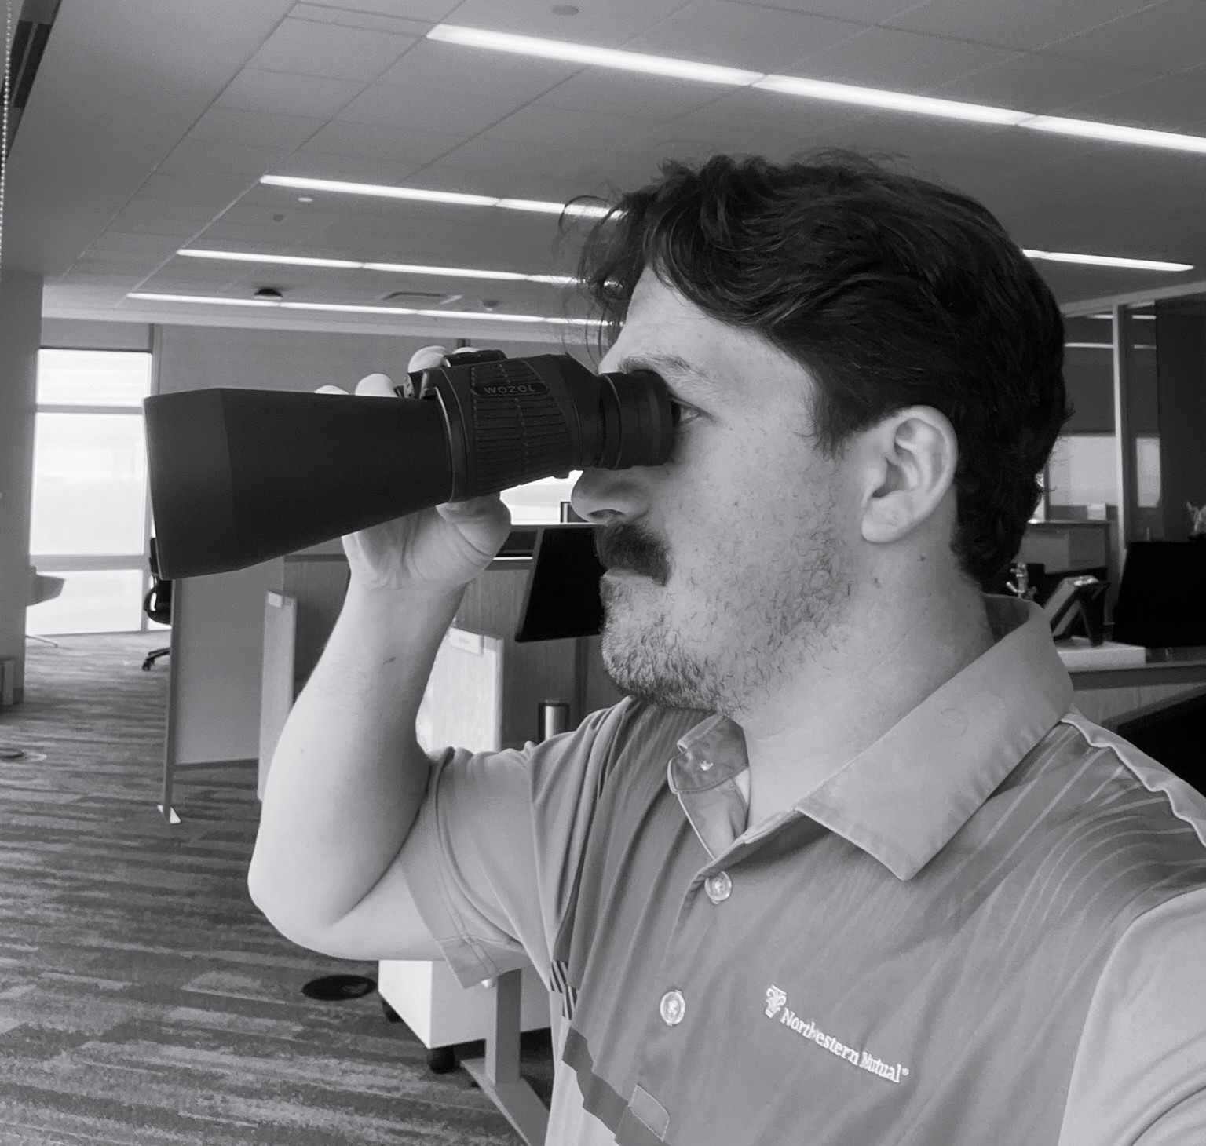


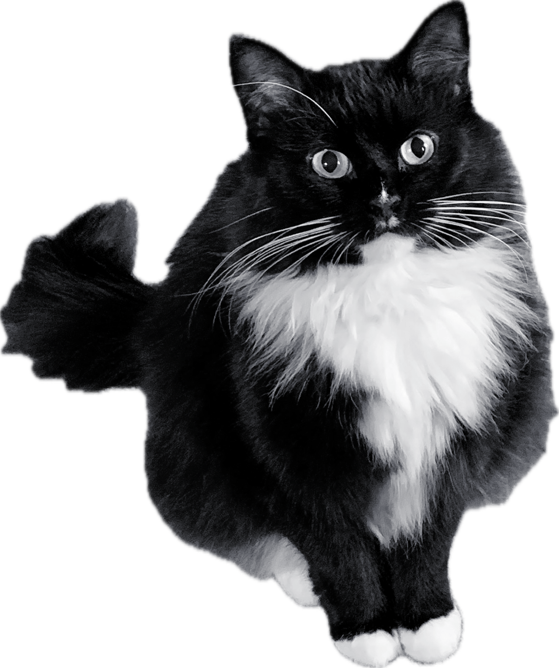
About Me
Splunker + Builder at Heart
10+ years in Splunk; lifelong learner
Focused on outcomes – love to fail fast and learn faster
Part-Time Harbor Patrol (Unofficial)
Fun fact: I can guess a boat’s size, make, year, and price from a glance
Avid boater & golfer
Family First
Proud husband and dad of 3 little ones
My wife is my biggest supporter – even during midnight Splunking
Certs
CISSP, GCDA, GPYC, GCIH, AD FTK, GIAC Advisory Board
Splunk Certified Cybersecurity Defense Analyst
“I love what I do – and I make sure work is fun!”

Slide 4
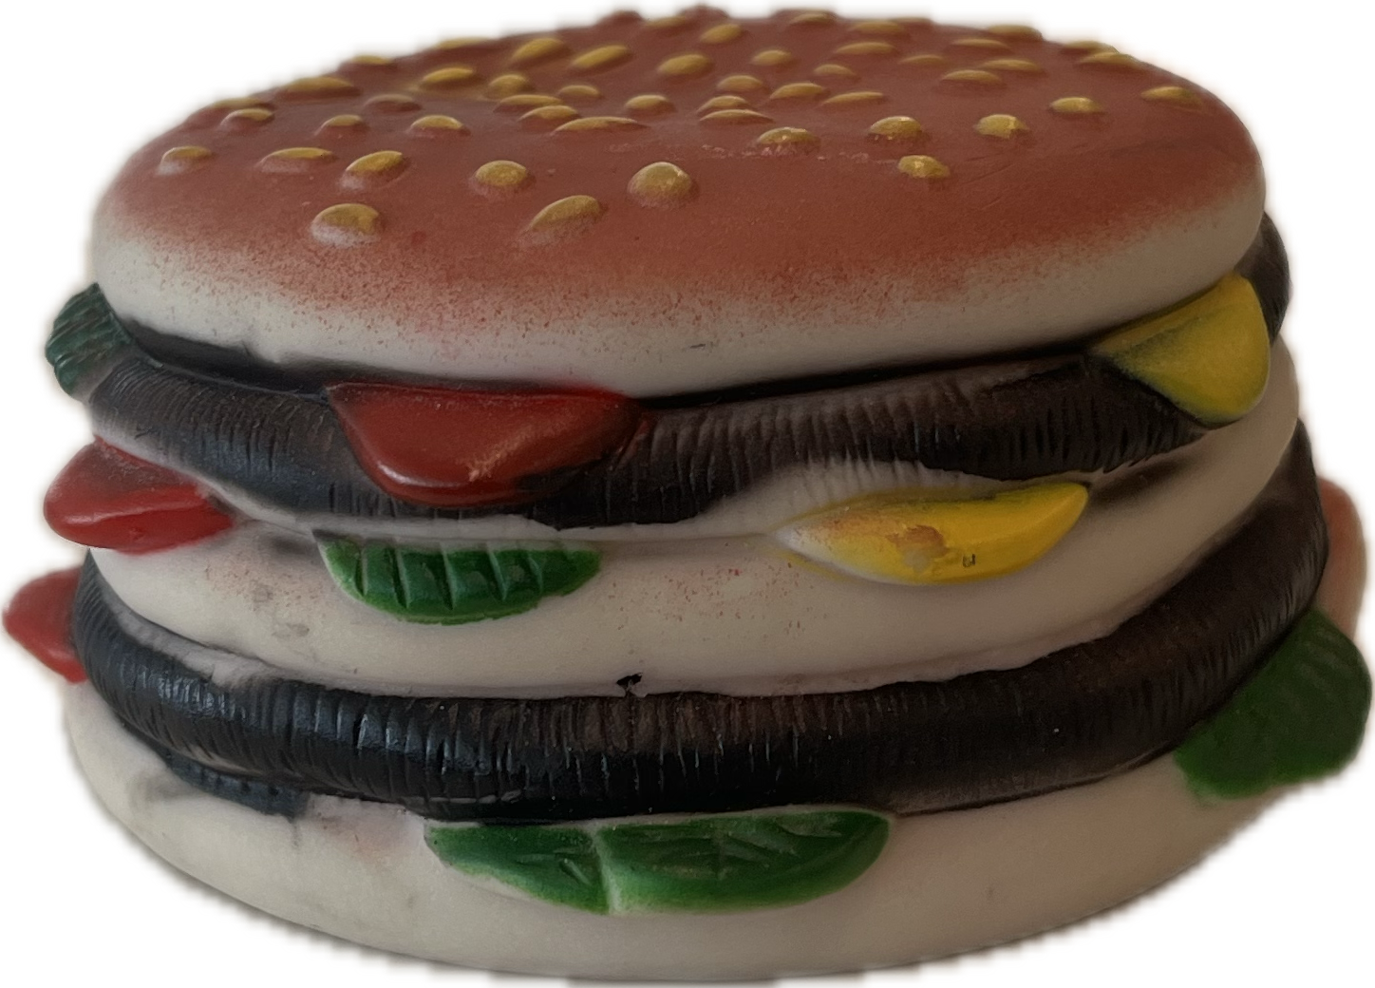
The Problem with Traditional Digital Forensics
Physical Access Requirements
Business Disruption
Limited Remote Capabilities
Inconsistent Analysis Results
Week Turnaround Time
“Nothing Burger”
Mail In Device
Image Device
Process Image
Detection/HR/Legal
Analyze
Remote Image Collection
Process Image
Has a 50/50 Chance Of Working
Notes:
4 talking points
Physical Access Requirement
Discuss the business disruption - Operational Impact
- Relationship Damage
“When we physically seize someone's primary device, were essentially treating them as guilty until proven innocent. This creates a lasting damage to employee trust and moral, even when investigations clear the individuals of wrongdoing.”
- Reputation Risk

Slide 5
The Shift – Direct Remote Collection with Splunk HEC
Notes:
Introduce Splunk HTTP Event Collector HEC is underutilized by security engineers
While this is nothing groundbreaking it's a different use for something we already have.
This is like living off the land like hackers.
Disclaimer about windows only while this same flow will still work
Maybe my next conf talk.

Slide 6






Our Solution: Real-Time Remote Evidence Collection
Windows Collections – Event Logs & File System
Analyst
Endpoint Agent
Script (PowerShell/Python)
HEC to Splunk
Detection
Notes:
Examples of these remote collections using splunk. Endpoint Agents are a requirement:
-Wazuh Active Response
-CrowdStrike RTR
-Tanium
-SCCM
-Carbon Black Live Response
-Intune

Slide 7
Our Solution: Real-Time Remote Evidence Collection
Windows Collections – Event Logs & File System
File System Artifacts
Collect high-value paths (e.g., AppData, Downloads, Recent, Desktop) for behavioral context.
Windows Event Logs
Target logs like Security (4624, 4625, 4670), Sysmon, PowerShell, and TaskScheduler for activity timeline.
Filter for Relevance
Use targeted collection to reduce noise and accelerate triage — don’t pull full disk images unless necessary.
Standardized Format for Investigation
Output logs and artifacts in structured formats (e.g., JSON, CSV) for seamless ingestion into Splunk dashboards and timeline tools.
Notes:
4624 - Windows Logon
4625 - Failed Logon Attempt
4670 - Permissions on an object were changed.

Slide 8

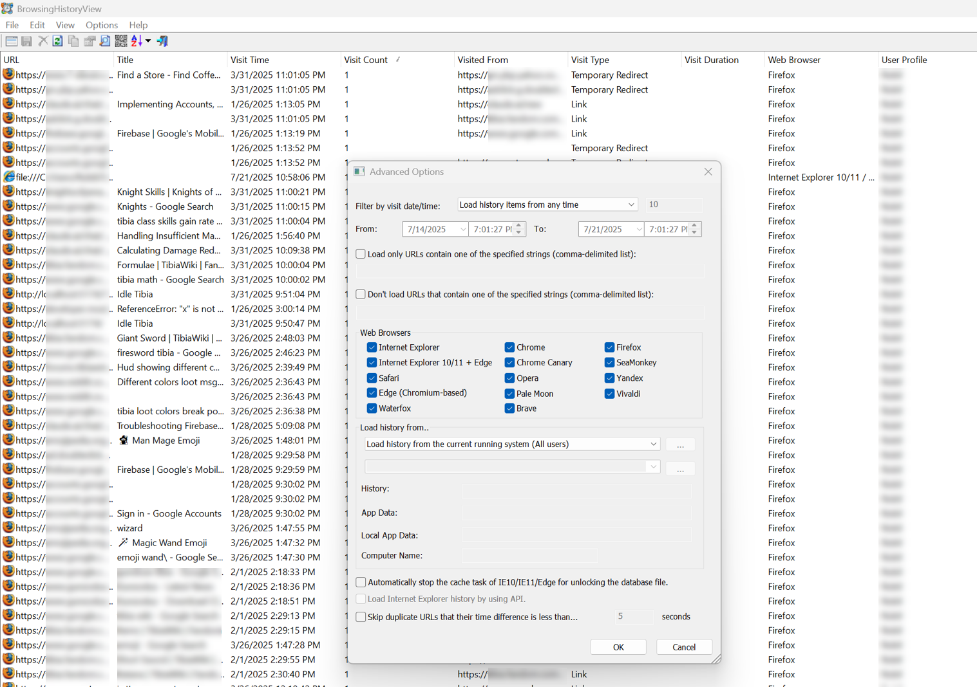
Our Solution:
Real-Time Remote Evidence Collection
Windows Collections – Browser History via BrowserHistoryView by NirSoft
Free utility by NirSoft for viewing browser history from multiple browsers
Supports Chrome, Edge, Firefox, Internet Explorer, Safari, and others
Lightweight utility runs silently—no installation required
Fully supports command-line options for seamless automation and scripting
Output is parsed and formatted as CSV
Ideal for forensic investigations, triage, or timeline building

Slide 9
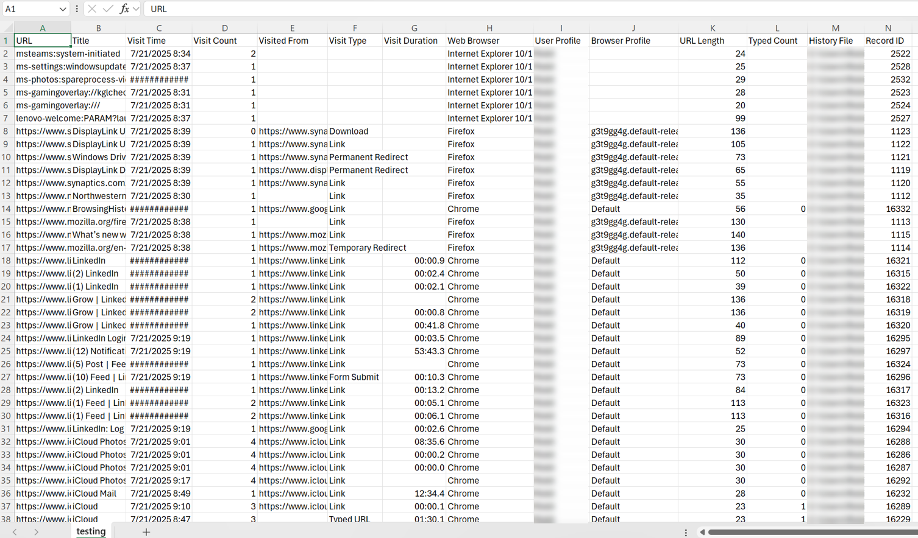
Our Solution:
Real-Time Remote Evidence Collection
Windows Collections – Browser History via BrowserHistoryView by NirSoft
Free utility by NirSoft for viewing browser history from multiple browsers
Supports Chrome, Edge, Firefox, Internet Explorer, Safari, and others
Lightweight utility runs silently—no installation required
Fully supports command-line options for seamless automation and scripting
Output is parsed and formatted as CSV
Ideal for forensic investigations, triage, or timeline building

Slide 10



Our Solution:
Real-Time Remote Evidence Collection
Windows Collections – Browser History via BrowserHistoryView by NirSoft
BrowserHistoryView
Analyst
Endpoint Agent
Script (PowerShell/Python)
HEC to Splunk
Detection

Slide 11
HEC Configuration Deep Dive
Requirements · Limitations · Best Practices
Requirements
Limitations
Best Practices
Splunk HEC enabled
Auth token with proper index/sourcetype permissions
HTTPS (recommended) for secure transmission
Define:
Input source type (e.g., json, browserhistory, eventlogs)
Index name for organizing data by
https://splunk.company.com:8088/services/collector)
Default payload limit: ~800MB per request
No built-in automatic file chunking
Requires network access from endpoint to Splunk
Implement batching/chunking for large payloads (e.g., splitting large timelines or CSVs)
Use modular scripts or SOAR actions for automation and repeatability
Add rich metadata to each event:hostname, username, artifact_type, and case_id
Apply consistent source types for clean ingestion (browserhistory, super_timeline, etc.)
TEST, TEST, and TEST SOME MORE!

Slide 12
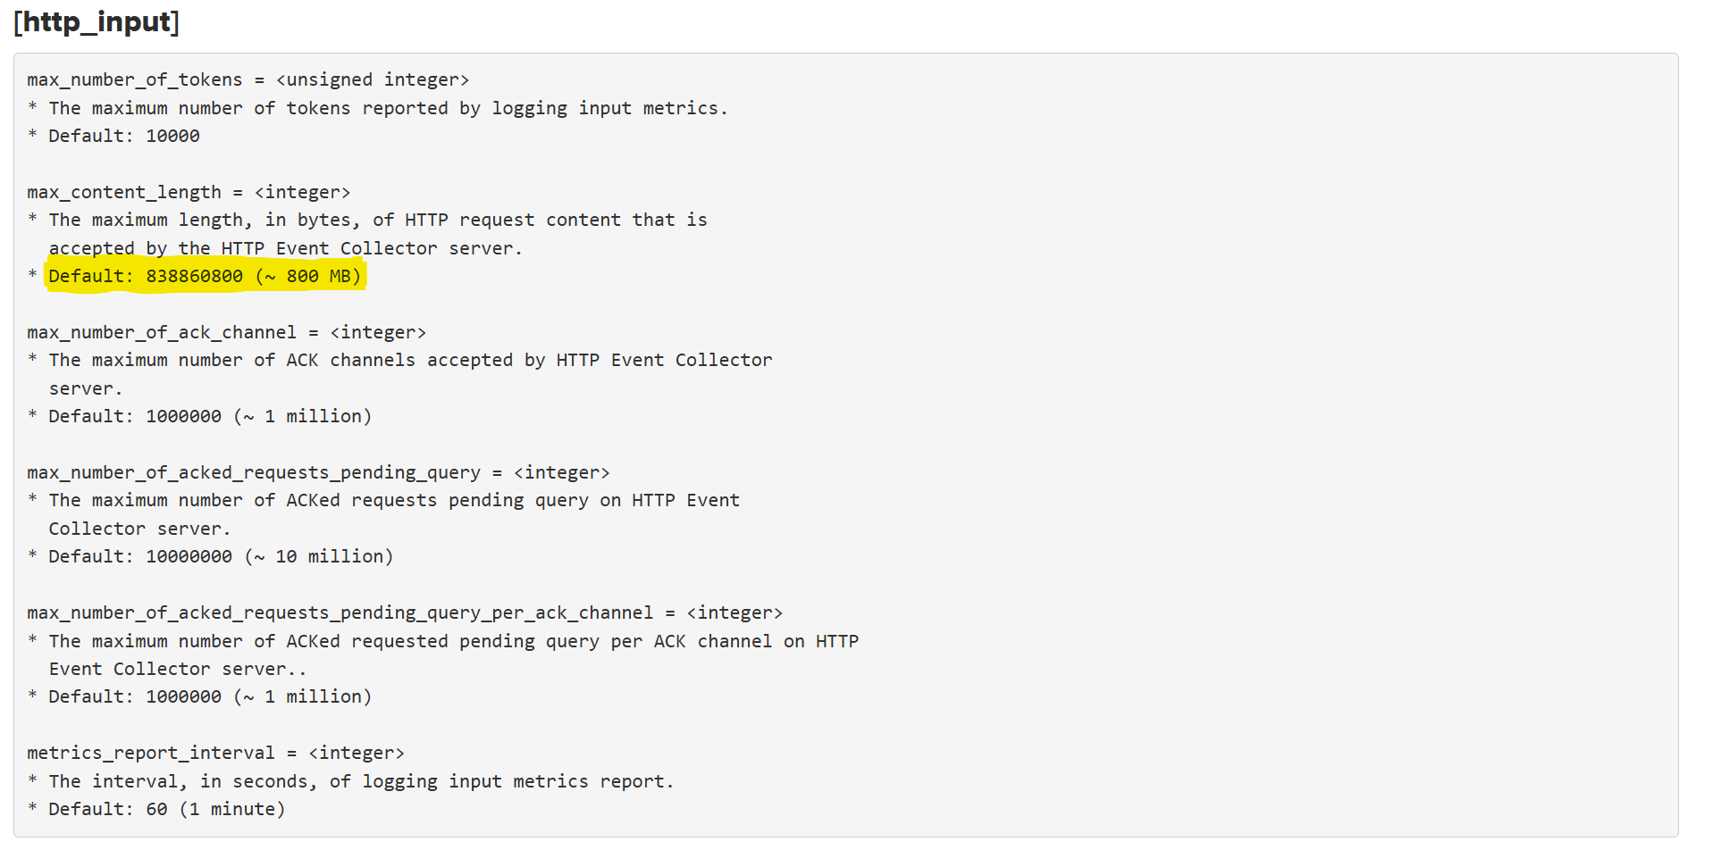
HEC Configuration Deep Dive
Requirements · Limitations · Best Practices
https://docs.splunk.com/Documentation/Splunk/9.4.2/Admin/Limitsconf

Slide 13
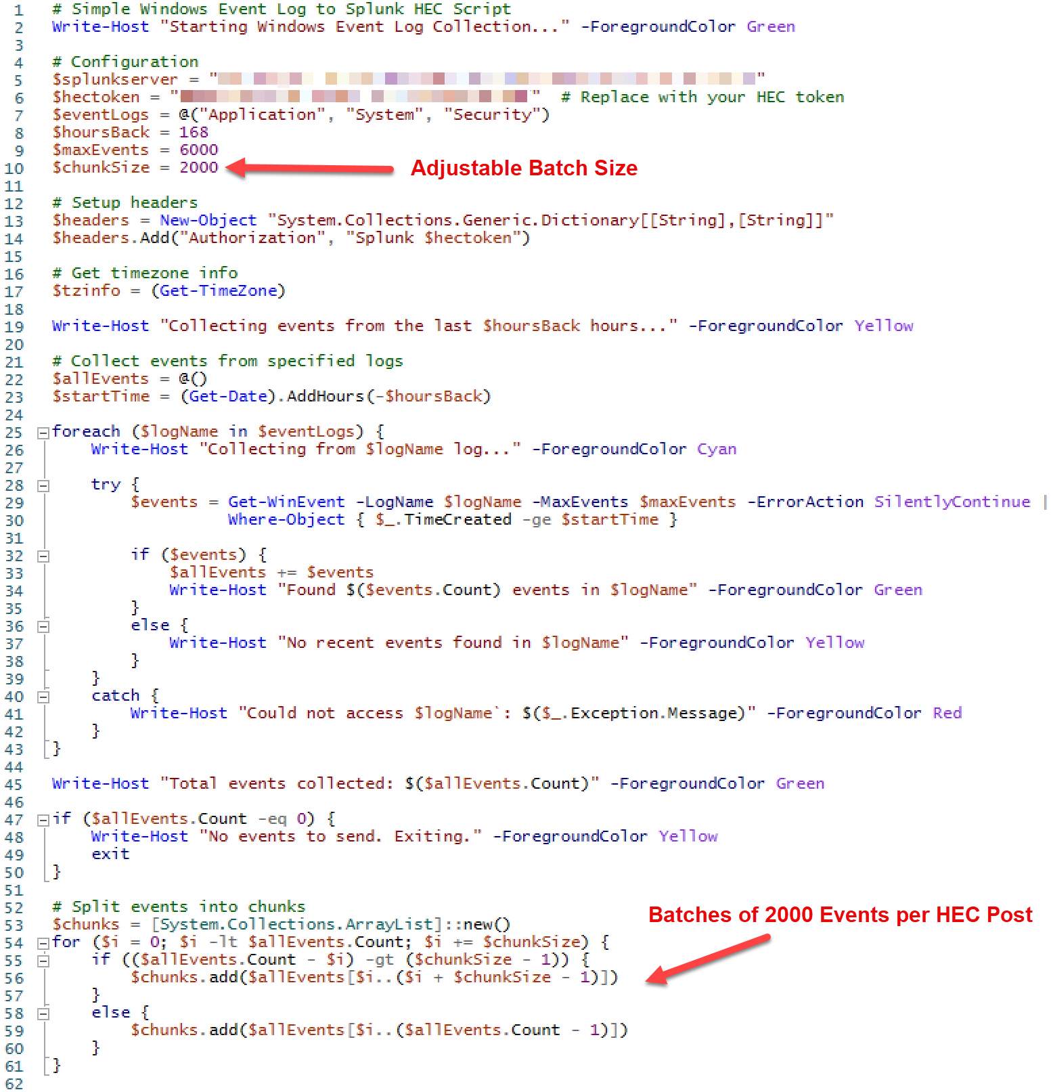

Slide 14
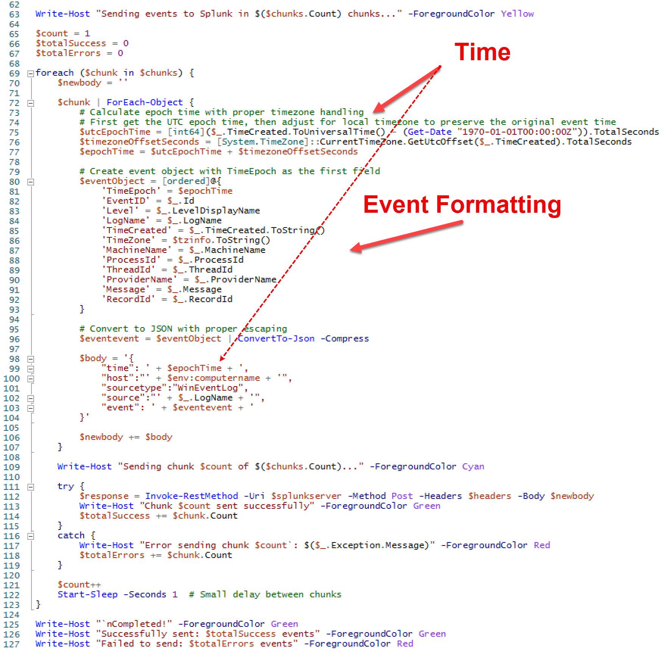

Slide 15
Demo
Time

Slide 16
Comprehensive Artifact Collection with KAPE & PLASO

Slide 17
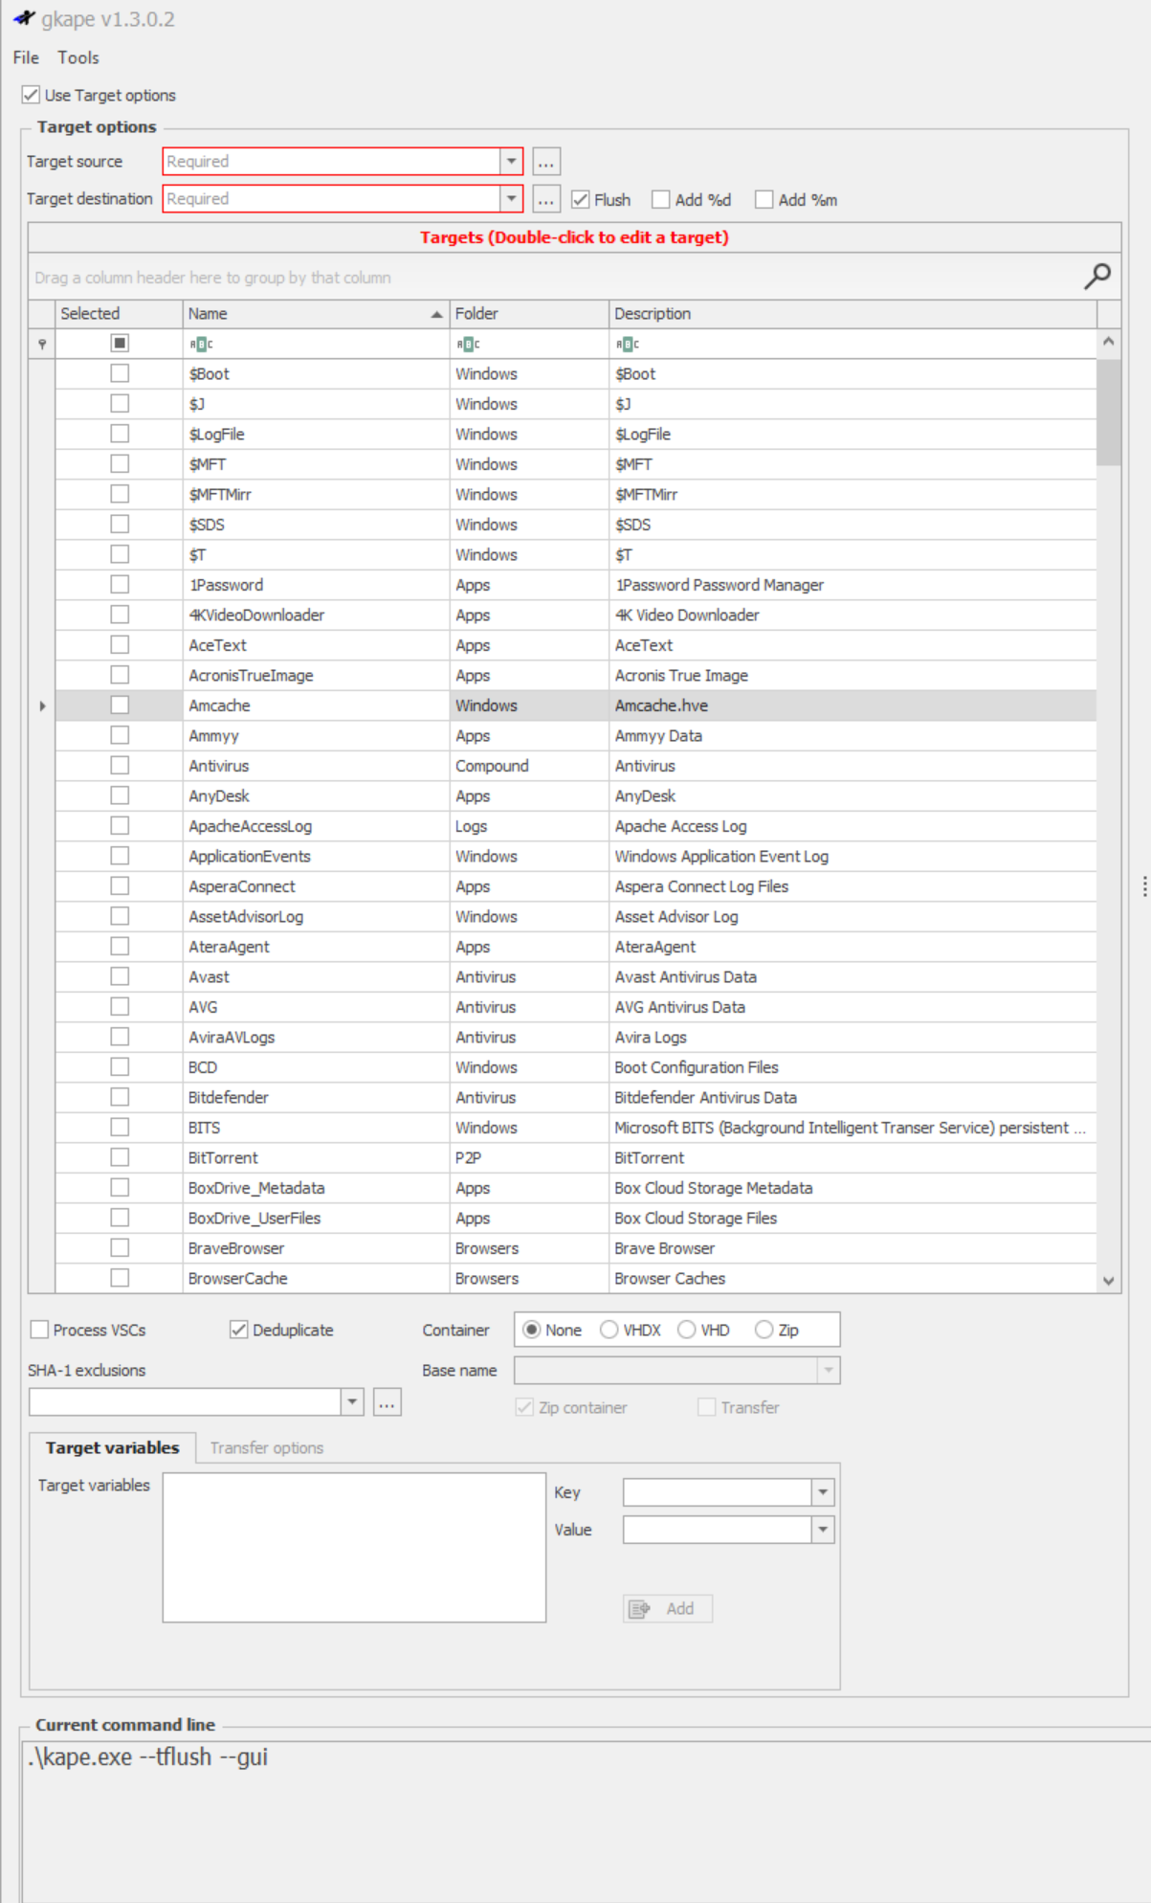
Kroll Artifact Parser and Extractor (KAPE)
When Local Processing Isn't Enough
Designed for rapid triage and targeted artifact collection on Windows systems
Uses pre-defined Target definitions to collect key forensic data:
Registry hives
AmCache
User activity
USB history
LNK files, Prefetch, etc.
Portable and scriptable — ideal for remote automation
Perfect handoff point to Plaso or other timeline tools
$MFT
Browser Data
Shellbags
SRUM
A LOT!!!!

Slide 18
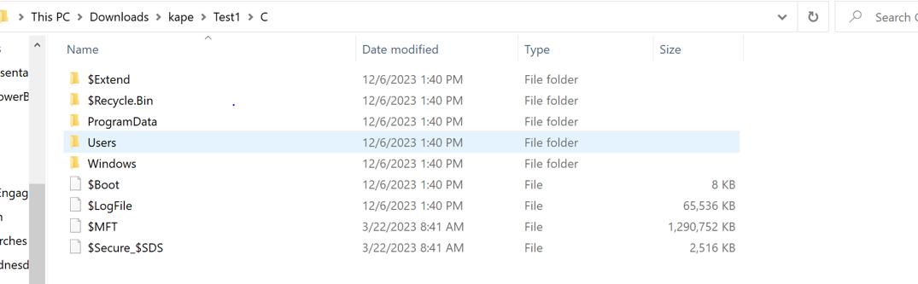
Kroll Artifact Parser and Extractor (KAPE)
From Quick Triage to Full-Scope Forensics

Slide 19

Plaso (log2timeline)
Super timeline all the things, is a Python-based engine used by several tools for automatic creation of timelines.
Parses KAPE-collected artifacts into a rich, unified SuperTimeline
Supports hundreds of parsers and plugins for deep forensic analysis:
Event Logs (EVTX), Web history, Registry, LNK files, Prefetch, $MFT, etc.
Normalizes diverse artifacts into a chronological timeline of system/user activity
Scalable and efficient processing of large data volumes
Automation and scripting capabilities
Ideal for incident reconstruction, insider threat investigations, and timeline correlation
Output formats include:
CSV/TSV – easy to audit or open in Excel
SQLite – ideal for forensic tooling
JSON – ideal for Splunk ingestion

Slide 20

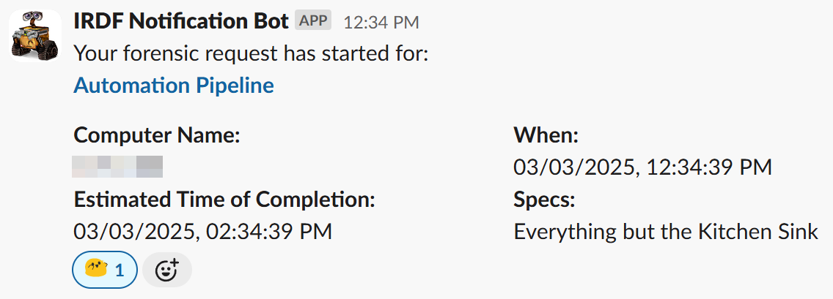



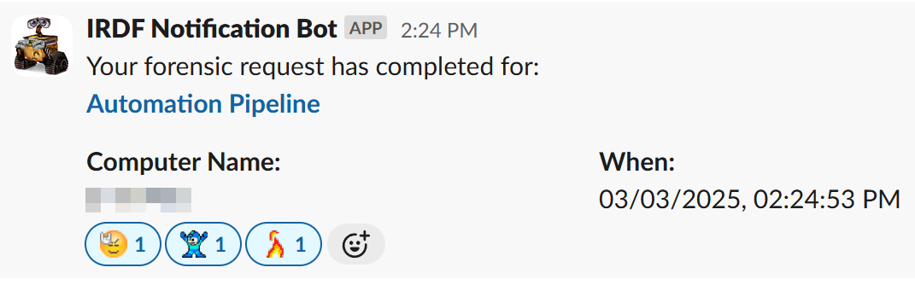



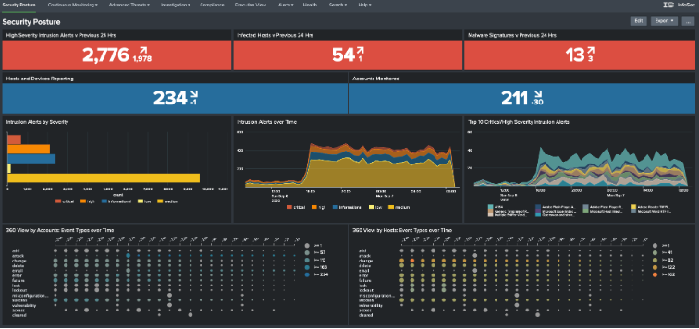

Supertimeline in Action
KAPE Collection
GitLab
Analyst
Slack
GitLab
Endpoint Agent
Script (PowerShell/Python)
Detection
Plaso PSort
Long Term Storage
Build
Download Remote File
log2timeline
Plaso PSort
SplunkHF/HEC

Slide 21
Demo
Time

Slide 22
Final Takeaways / Lessons Learned
“80% today is better than 100% a year from now.”
Start small – one script, one data source, one win
Modular collection scales fast – reuse the same pipeline across many artifact types
Splunk HEC is powerful – but planning for metadata, batching, and scale is key
Timeline correlation brings clarity fast
KAPE + Plaso = deep visibility – without burdening the endpoint
Build tools for the analyst, not the engineer
From detection to decision – you can cut response time from weeks to minutes
Notes:
don't let perfect be the enemy of good!

Slide 23
Q&A

Slide 24
Thank you.
Let’s Connect!
From Weeks to Minutes — Let’s Bring DFIR to Real-Time.
Alex Robillard
Lead Detection & Automation Engineer
Insider Risk & Digital Forensics @ Northwestern Mutual
Email: alexrobillard@northwesternmutual.com
GitHub: github.com/Alspeedo/SplunkConfSEC1780
LinkedIn: linkedin.com/in/alex-robillard-0a923154/
Slides, Scripts, examples available on GitHub repo

